Slide 1
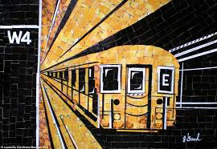

ÖZLEN SÖNMEZ KÜBRA ERENSOY HÜSEYİN AYDOĞAN ATALAY BARUT MUHAMMED KARAÇOBANOĞLU
WTWY MTA TRAFFIC ANALYSIS
As First Project of
Istanbul Data Science Academy
01

Slide 2

Introduction
WomenTechWomenYes is holding an annual gala, and hopes to invite as many interested individuals as possible.
Our Goal
To find out the which stations and days in a week are the busiest in the resource.

Slide 3






Methodology
- MTA Turnstile Data (January 2018 – 2021)
Tools
Python
Matplotlıb
Pandas
Numpy
Seaborn
Jupyter Notebook

Slide 4
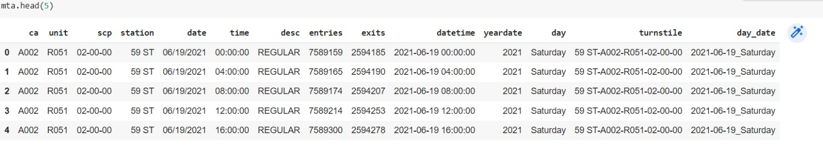
DATA EXPLORATION
Looked For Duplicated And Null Values In The Data Set. Dropped Some Columns From The Data And Changed The Names Of Them. Added The Day Column To Data Set.

Slide 5
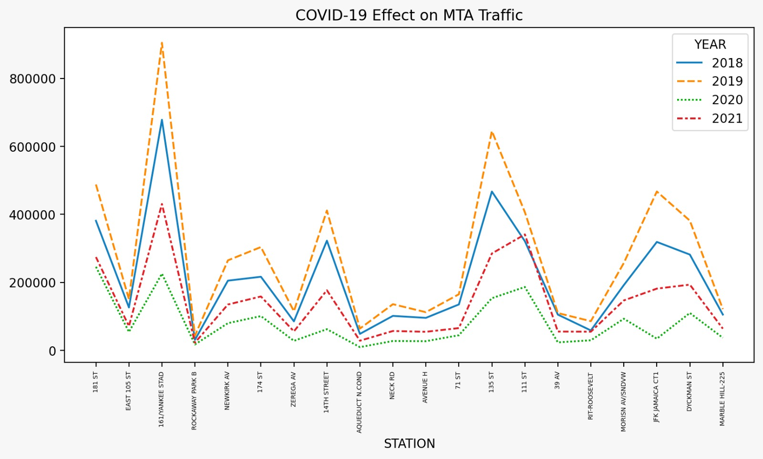
PANDEMIC EFFECT

Slide 6
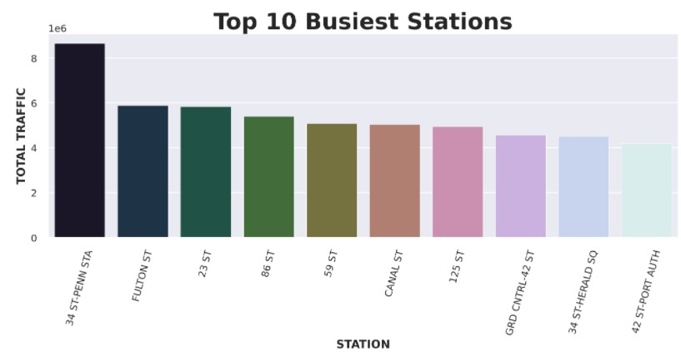
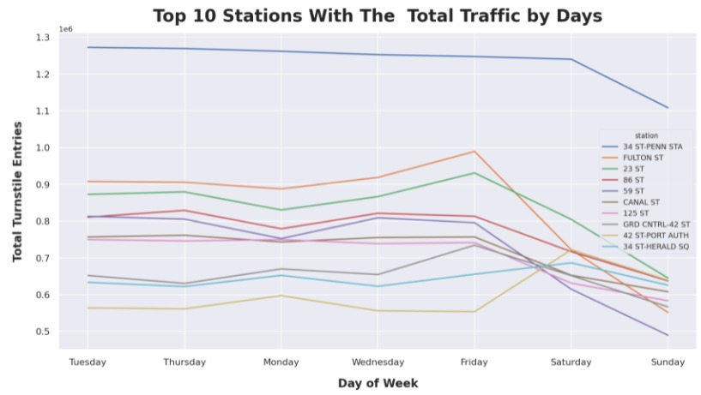
RESULTS

Slide 7
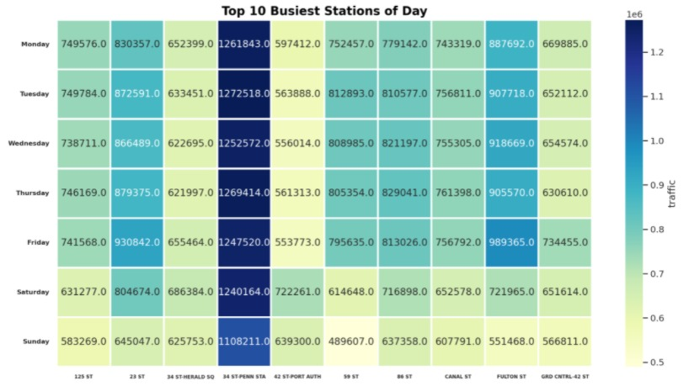
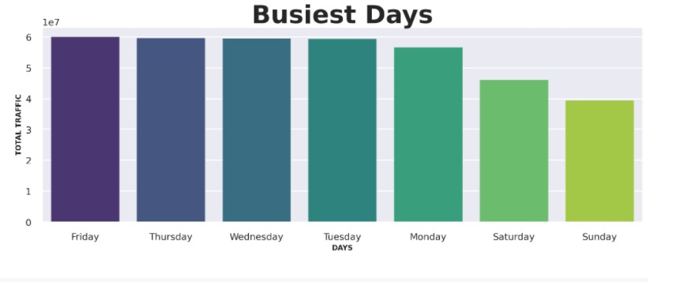
RESULTS

Slide 8
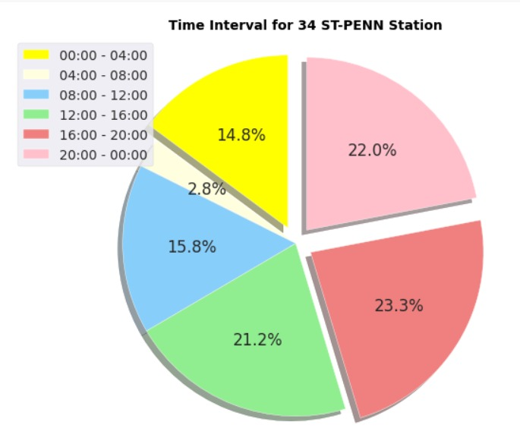
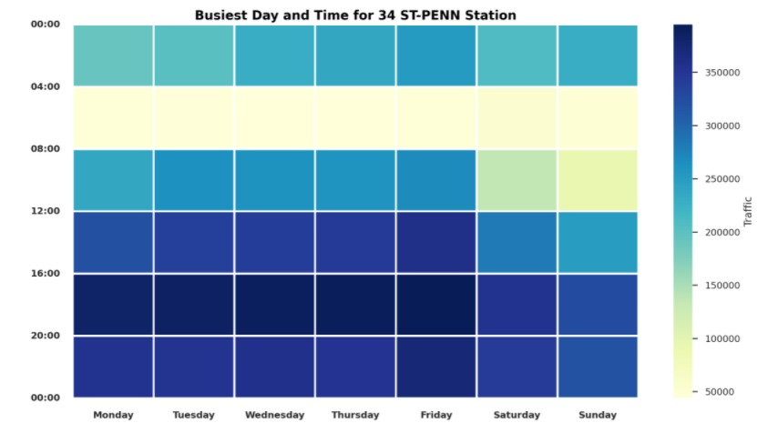
RESULTS

Slide 9
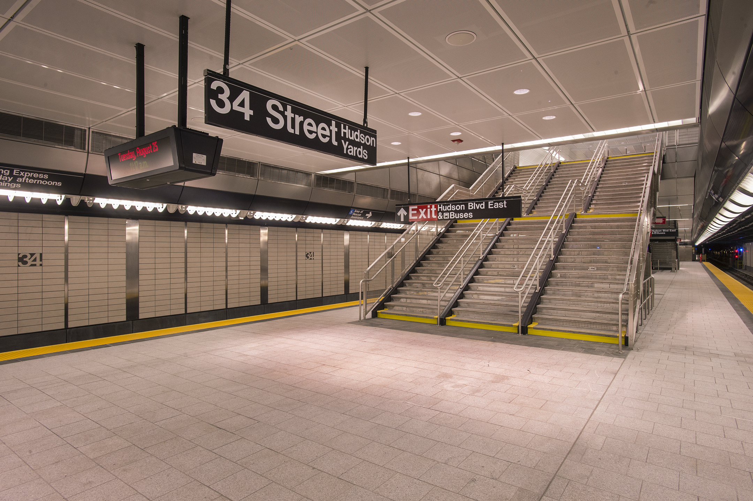
CONCLUSION
Weekdays are busier than Weekends. The busiest days are Tuesday, Thursday and Wednesday.
WTWY should focus their street efforts in the top 10 stations, preferably in the busiest days to avoid wasting their resources.
34 ST-PENN STATION should be the first option If time and resources are limited. The best time interval is 16:00 to 20:00 due to the highest traffic during the day.

